Slide 1
IoT Byte-Sized: IoT Security & Compliance
WELCOME!
Allen R. Sanders
Senior Technology Instructor

Slide 2

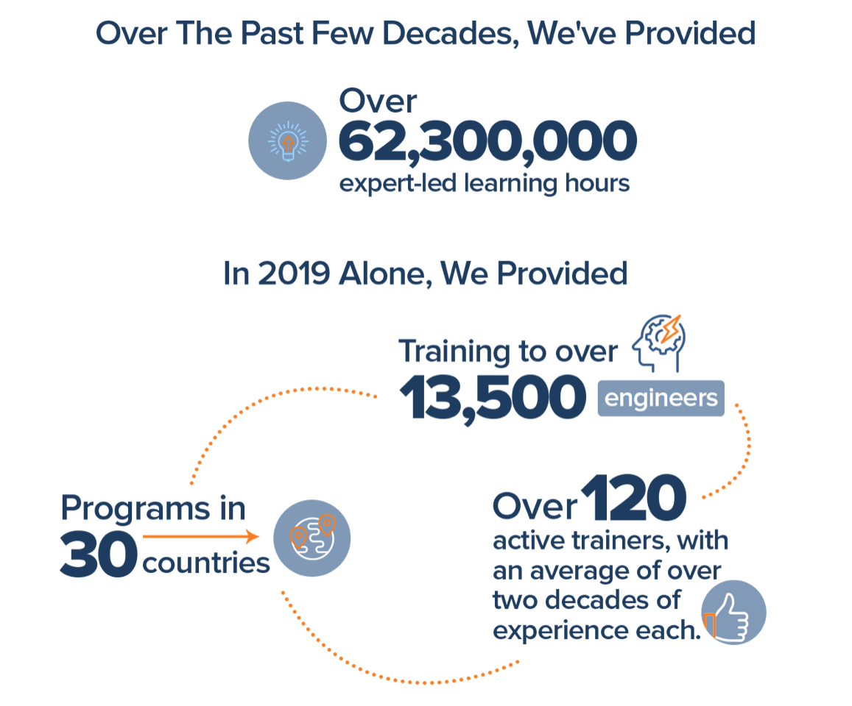
Join Us in Making Learning Technology Easier
Our mission…
Over 16 years ago, we embarked on a journey to improve the world by making learning technology easy and accessible to everyone.
…impacts everyone daily.
And it’s working. Today, we’re known for delivering customized tech learning programs that drive innovation and transform organizations. In fact, when you talk on the phone, watch a movie, connect with friends on social media, drive a car, fly on a plane, shop online, and order a latte with your mobile app, you are experiencing the impact of our solutions.
Copyright DevelopIntelligence LLC
Notes:
ACTION: Share a bit about DevelopIntelligence
- As developers you want to learn!
- As a corporation you want your developers to align their learning with your business goals.
- That’s where we come in… Keeping developers current, bringing others up-to-speed … all aimed at moving your business forward!
- DI was started in 2003 by a Sun Microsystems developer that wanted to help developers level-up and see business better leverage IT

Slide 3
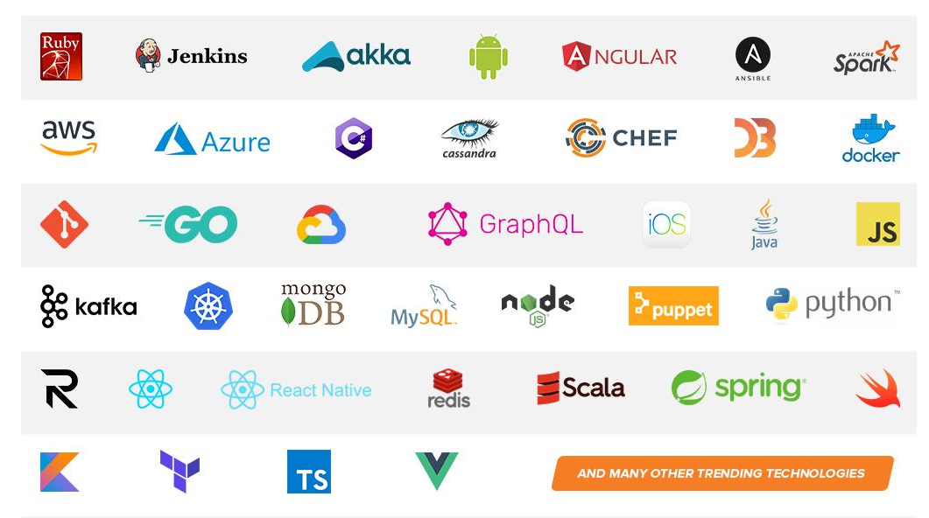
Technologies we cover
Notes:
ACTION: Share some of the technologies we teach
Areas of DevelopIntelligence expertise
DevOps: Ansible / Jenkins
BigData: Hadoop / Cassandra / Spark
Machine Learning
Front-end: React / Angular
Cloud: AWS / Azure / Google Cloud
- Started as a Java shop -> kept growing -> haven’t looked back
- Our specialty is hiring expert practitioners that can come alongside teams and teach them how to move forward

Slide 4
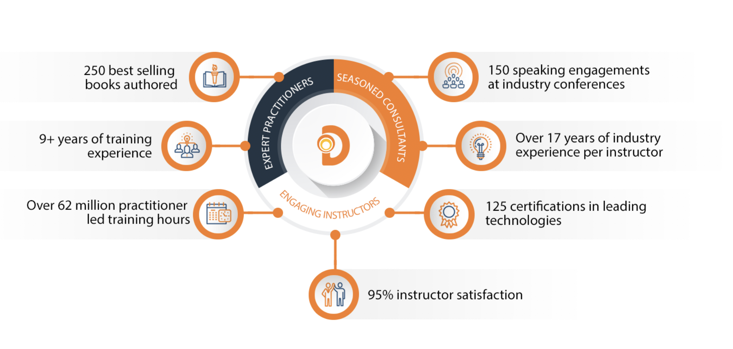
World Class Practitioners
Notes:
ACTION: Share about what makes the DevelopIntelligence instructor team one of-a-kind!
Here is some data showing instructors are expert practitioners, engaging instructors, seasoned consultants. We are the best in the business!

Slide 5



Virtual Training Expectations for You
Arrive on time / return on time Mute unless speaking Use chat or ask
questions verbally
Notes:
ACTION: Share the expectations you have for the students
Level set the rules of engagement for virtual classrooms. Encourage students to be on time! Just because this is a virtual class doesn’t mean it’s ok to inconvenience peers who showed up on time.
Mute yourself unless asking a question/commenting
Ask questions (verbally or via chat window)

Slide 6
Virtual Training Expectations for Me
I pledge to:
Make this as interesting and interactive as possible
Ask questions in order to stimulate discussion
Use whatever resources I have at hand to explain the material
Try my best to manage verbal responses so that everyone who wants to speak can do so
Quick review of key Zoom features that may be helpful for our course
Notes:
ACTION: Share the expectations the students should have for you
Level set to the students what they can expect from you. Instructor will do the best to mix it up…
Zoom tools, hands-on, breaks, group work, break out rooms… keep it interesting and interactive

Slide 7
Purpose
Gain a deeper understanding of security and compliance concerns with IoT (both devices and data)

Slide 8
Objectives
Upon completion of this course, you should be able to:
Understand the security risks associated with IoT devices and data
Describe the typical threat zones within IoT
Explain how to secure device identity, software and hardware
Use threat modeling techniques with IoT

Slide 9
Introduction

Slide 10
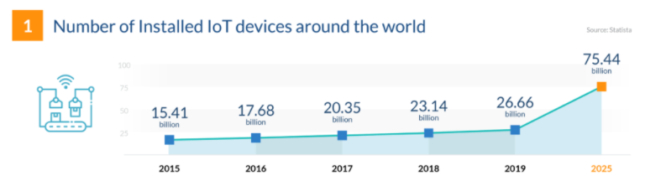
Industry Trends
From https://financesonline.com/iot-trends
Challenges potentially encountered with that amount of projected growth?

Slide 11
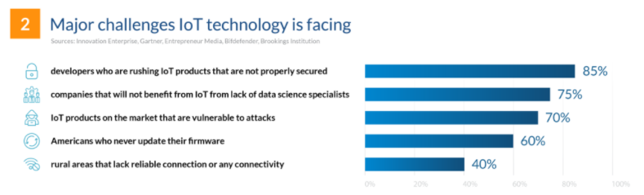
Industry Trends
From https://financesonline.com/iot-trends
Options for mitigating those challenges?

Slide 12
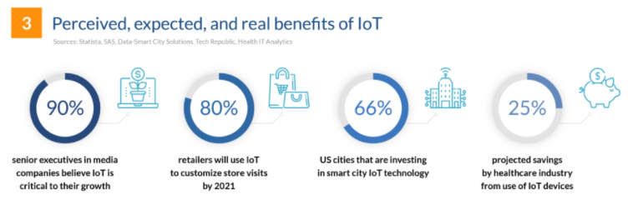
Industry Trends
From https://financesonline.com/iot-trends
How do we help customers realize those benefits?

Slide 13
Industry Trends
Areas of focus:
Accommodating orders of magnitude of growth
Preventing known (or unknown) challenges from impeding success
As a business, effectively leveraging opportunities to meet customer needs
Device Management
Leveraging the Edge
Data Management

Slide 14
Security & Compliance

Slide 15
Standards & Compliance Categories
Can include:
By geographical region
By industry
By technology

Slide 16

Standards & Compliance by Region
Standards and compliance enforcement can vary by area of the world
For example, the EU likely has different requirements than the US:
Federal Communications Commission (FCC) certification in the US
General Data Protection Regulation (GDPR) in the EU

Slide 17
Standards & Compliance by Region
Can include considerations for:
How data is transmitted
How data is secured, managed, and used
Physical or systems security of the device or Edge component itself

Slide 18
Standards & Compliance by Region
Failure to adhere can limit ability to do business in the region
Or can result in significant penalties and/or reputational damage
Can add permutations to approach to build out of the tech

Slide 19

Standards & Compliance by Industry
Different industries may have different regulations
There can also be a difference in physical requirements
Think remote oil field vs. data center vs. nuclear power plant
Notes:
Durability

Slide 20
Standards & Compliance by Industry
Regulations often driven by types of data being gathered
Medical devices likely subject to HIPAA regulations
Point-of-Sale (POS) devices may require PCI compliance

Slide 21
Standards & Compliance by Industry
Depending on the industry, failure to comply may have devastating impact
Think potential exposure for autonomous vehicles, for example

Slide 22

Standards & Compliance by Technology
Today’s devices offer multiple technology options
Some options better accommodate specific operating requirements
For example, low power/long range or more robust remote connectivity
Let’s look at a few

Slide 23
Standards & Compliance by Technology
Bluetooth Smart (aka Bluetooth Low Energy or BLE):
Wireless PAN (Personal Area Network) technology
Targets considerably reduced power consumption with comparable comm range
Goal is smaller size (and, by extension, lower cost)
Compatible with large install base of existing mobile and computers

Slide 24
Standards & Compliance by Technology
DECT Ultra Low Energy (ULE):
Wireless technology targeting smart home applications
Includes home automation, home security, and climate control
Basic implementation uses a “star network topology” – base + nodes
Ample range coupled for lower power consumption

Slide 25
Standards & Compliance by Technology
ZigBee:
Designed for small scale projects requiring wireless connectivity
Used in home automation, medical device data collection, etc.
Low power consumption
Also, low bandwidth, low data rate, and requires closer proximity
Intended to be simpler and less expensive
Can integrate with a mesh network to extend reach

Slide 26
Standards & Compliance by Technology
6LoWPAN:
Acronym for IPv6 over Low-power Wireless PAN
Uses encapsulation and header compression
Enables send of IPv6 packets over LR-WPANs (low-rate wireless PAN)
Targets devices with very limited form factor

Slide 27
Standards & Compliance by Technology
LoRaWAN:
Proprietary long-range/low power technology for wide area networks
LoRa defines physical layer
LoRaWAN defines upper networking layers
Cloud-based protocol
Acts as network layer protocol for managing comm between devices and gateways
Notes:
Talk about example – temperature and humidity sensors

Slide 28
Assessing Security Risks
To secure a solution, attack surfaces and potential threats must be identified
Common practice utilizes something called threat modeling
Includes modeling and analyzing possible attack vectors based on application

Slide 29
Assessing Security Risks
Risk assessment should account for different “zones” of execution
Security requirements for device in remote oil field different from secure data center
And, ideally, threat modeling would be executed during design & dev phases

Slide 30
Typical Threat Zones
Devices
Field Gateways
Cloud Gateways
Software Services

Slide 31
Security Considerations
Effective Edge/IoT systems depend on a trustworthy network of:
Data producers
Data consumers
Potential exposure could include physical tampering with a device in that network
But tampering might also include considerations as well

Slide 32
Security Considerations
Need to be able to trust and secure:
The identity of a device
The integrity of the software running on it
The integrity of its hardware
The data sent or stored
Applies to both a sensor and Edge device (gateway, etc.)

Slide 33
Securing Device Identity
As discussed in section on device provisioning, devices are registered securely
Often utilizes one of the following to secure identity:
An X.509 certificate securely stored on the device
Trusted Platform Module (TPM) providing chip-based security configuration
Identifies and provides ongoing verification of device with data target

Slide 34
Securing Device Identity
Only registered devices should be able to connect and send data
Secure identity can periodically (or continually) be verified
Keys used to affirm identity must be protected
Secure identity is about establishing a trust relationship

Slide 35
IoT Device Certificates
According to studies, IoT devices are under attack within 5 mins of coming online
Complex attacks on networks increase every year (2,851% growth since 2017)
Device certificates can support secure identity and encryption

Slide 36
IoT Device Certificates
May leverage Public Key Infrastructure (PKI)
Digital certificate – AKA public key cert; cryptographically links public key with owner
Certificate authority (CA) – trusted party/entity that issues digital security cert
Registration authority (RA) – AKA subordinate CA; authenticates requests for a cert and then forwards to CA
Certificate store – storage system (e.g., database) containing info about issued keys and certs

Slide 37
IoT Device Certificates
Combined with device registration
Cert is associated with registered device and used like a network “passport”
Ensures added layer of security which is revokable (even for registered devices)

Slide 38
Provisioning IoT Device Certificates
Third-party certificate vendors and scalable, managed digital cert services
High-volume private cert management, especially for behind the firewall
High-volume private cert uses MDM (mobile device management) systems to generate and distribute certs
Low-volume manual cert management – simpler but can be less secure/scalable

Slide 39
IoT Device Certificates – Benefits
Additional layer of security and data encryption
Maintains immutable record of activity with dates, time, and key detail
Enable tamper-resistant features – in software and/or data

Slide 40
IoT Device Certificates – Challenges
Managing certs can be time consuming and difficult, especially for large fleets
Need to proactively manage expiration dates which can vary greatly
The wrong provisioning strategy can make it difficult to succeed

Slide 41
Securing Device Software
Edge/IoT devices are often common, commodity implementations
Streamlined commonality helps to keep down costs
However, can also lead to exposure

Slide 42
Securing Device Software
When implementation is common, attack vectors may be well-known
For a given device type, attackers may already have tried & true strategies
Enforced standards can lead to advanced understanding of vulnerabilities

Slide 43
Securing Device Software
Attackers do not necessarily need to assume device identity
Can inject malicious code into existing software flow where identity appears valid
Software integrity is usually verified using code signing mechanisms
Notes:
Helps to affirm software not tampered with

Slide 44
Securing Device Hardware
Secure software running on insecure hardware is still exposed
Devices (especially Edge devices) need hardware root of trust
There are a couple of options:
Trusted Platform Modules (TPMs)
Hardware Security Modules (HSMs)

Slide 45
Securing Device Hardware – TPM
Set of protocols that can be implemented in hardware, firmware, or software
Firmware or software options represent “virtual” TPMs
Not as secure as the hardware implementation
Storing keys in TPM prevent malicious attempts to retrieve

Slide 46
Securing Device Hardware – HSM
Custom, vendor-provided modules for securing hardware
Need to confirm integrity and security of module for target application
Will likely also need a “wrapper” that enables API-based integration with the HSM

Slide 47
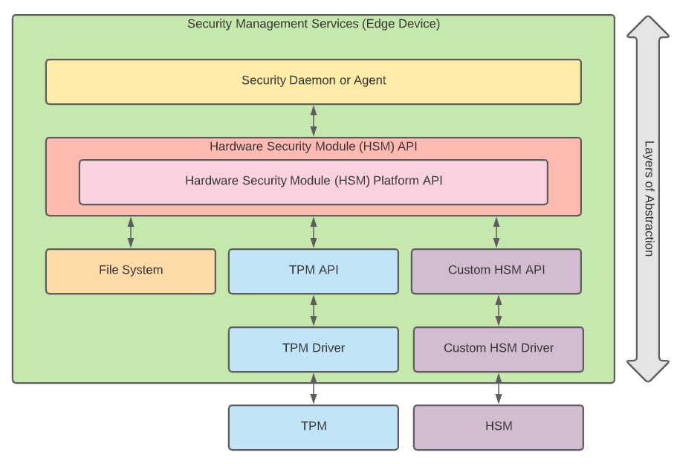
Securing Device Hardware
Uses end-to-end secure certificate generation and transmittal functions for establishing trust relationships across the components
Notes:
Platform API – platform abstraction layer that abstracts actual hardware capabilities on device; delegates security operations to a hardware-specific driver

Slide 48
Security Promises
Represent capabilities or guarantees for security of keys
Three common types:
Standard promise
Secure element
Secure enclave

Slide 49
Standard Promise
Supports previously described security workflow
Guarantees persistence of secrets on Edge device’s file system
Usually utilized to facilitate startup tasks for initial build out of Edge/IoT network
Not viable for production usage – should be seen as dev or test-only option

Slide 50
Secure Element
Supports all capabilities available with standard promise
Adds secure storage of secrets in TPM or HSM
Baseline recommended approach for production

Slide 51
Secure Enclave
Supports all capabilities available with secure element
Also allows definition of something called Trusted Applications (TA)
Enables security of runtime environment in addition to secrets

Slide 52
Secure Enclave
TA runs within Trusted Execution Environment (TEE)
Provides a protected execution workspace (or enclave)
Prevents any outside access to code running in the TEE

Slide 53
Secure Enclave
Part of an emerging trend called Trusted Edge Computing
Helps protect against new attack vectors arising from modern Edge integration
More secure but provides code built for TEE

Slide 54
Securing Data in Motion
Security required as data flows through the ether between producer and consumer
If attacker able to intercept information flowing between the two:
Potentially exposes sensitive information contained within header or payload
Could allow insertion of alternate, damaging control instruction for C2D

Slide 55
Securing Data in Motion
Certificate/secrets-based Transport Layer Security (TLS) can be used to protect
Highlights the previously discussed need to protect security keys
Impact can range from trivial to devastating (depending on application)
Notes:
IoT application used to track levels of hand sanitizer around a building to prevent someone from having to regularly check is trivial
Real-time instructions required for emergency medical care is potentially devastating

Slide 56
Securing Data at Rest
Aggregated data stored on a device in plain text can create a vulnerability
In previous topic on data management, goal is gained intelligence from the data
If the data at rest has been compromised:
May lead to inaccurate conclusions from analysis
Could provide competitor or bad actor access to a company’s competitive advantage
As with “in motion”, certificate-based encryption in storage is key

Slide 57
Threat Modeling
Scenario #1: Mesh-enabled network of security cameras aggregating video from a college campus to help monitor and ensure safety of students & faculty
Scenario #2: System of devices and Edge technology used to track train cars entering and leaving loading & dispatch stations and their cargo
Scenario #3: System of devices and Edge technology used to monitor multiple drills in large oil fields for malfunction or required maintenance
What are the potential attack vectors in the scenario?
What are the potential consequences if a vulnerability were exploited?
What are some high-level approaches that could be taken to secure?

Slide 58
Demo

Slide 59
THANK YOU

